Slide 1

Near Field Communication
Belimo NFC

Slide 2
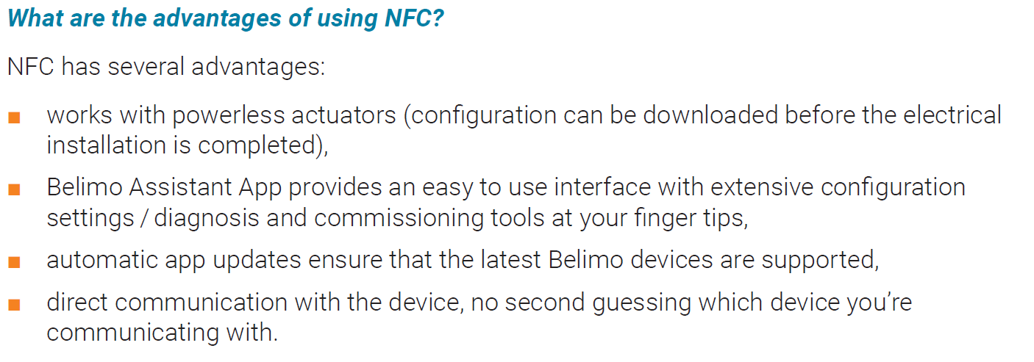
Belimo NFC

Slide 3
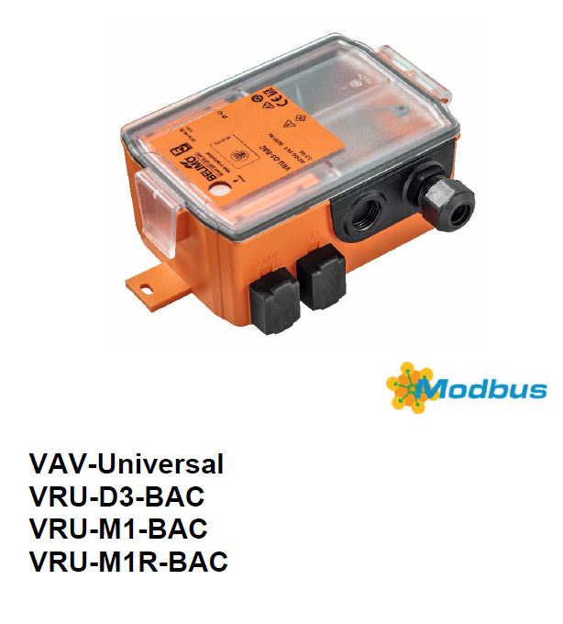


Modbus & Modus Poll
VAV Compact
LMV-D3-MOD

